Slide 1
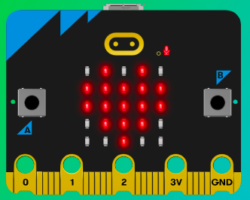
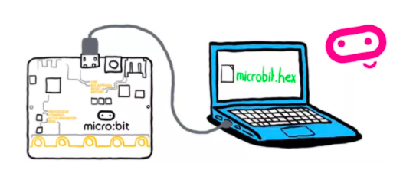
MicroMakers!
KIDS’ MAKER CLUB OF WASHINGTON, DC
Meet Up #2

Slide 2
RECAP!
Inputs, Outputs, Processors, Programs
Micro:bit – What is it?
Micro:bit – What should we remember when caring for it?

Slide 3
LEDs and Buttons!
Getting to know our inputs and outputs

Slide 4

Notes:
Pop quiz: Is an LED an input, an output, or a processer?

Slide 5

Notes:
Pop quiz: Is a button an input, an output, or a processer?

Slide 6
PART I: Icons and Animals
Let’s start making!

Slide 7
MAKER STEPS!
Follow these steps for each of our projects
Project Description
How Does it Work?
Read the Code and Start Making!
Share it!
Improve it!

Slide 8
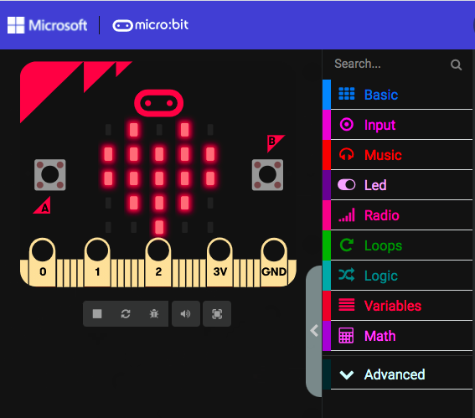
MAKER TIPS!
Use the simulator to test your code before downloading it!

Slide 9
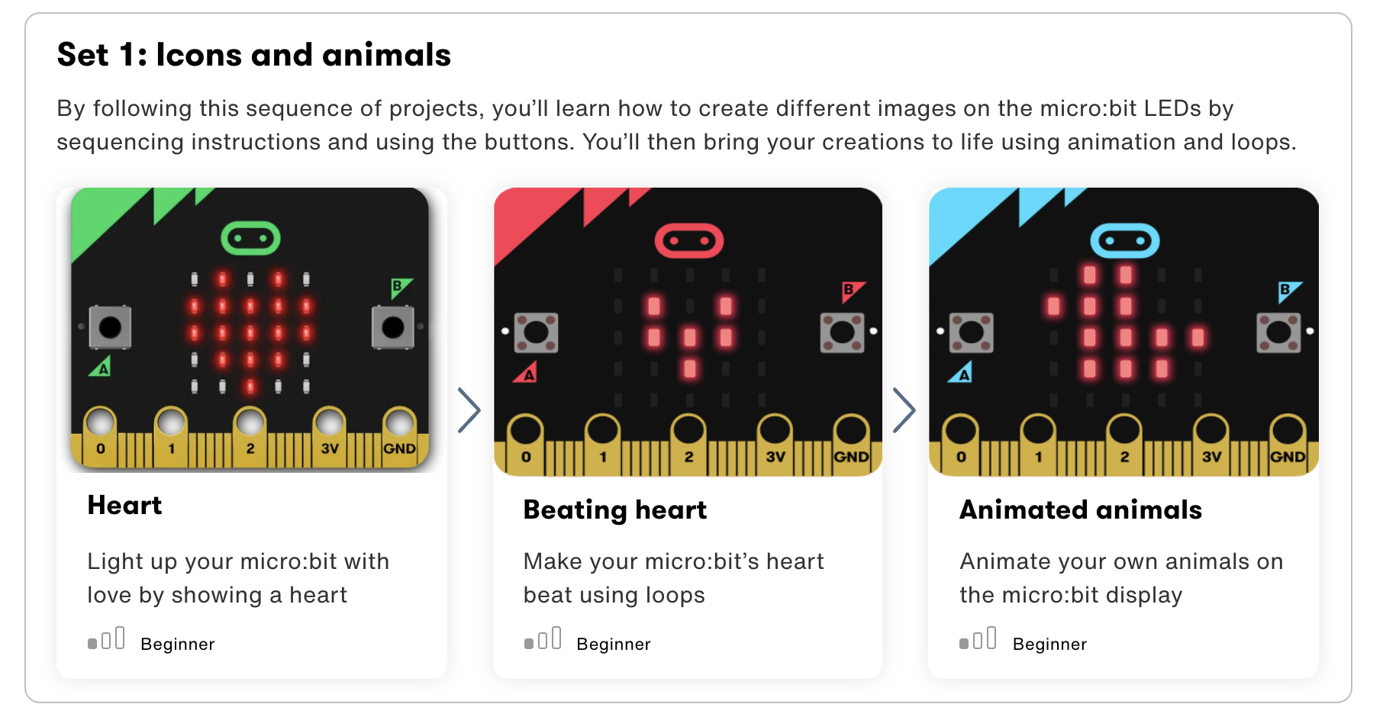

Slide 10
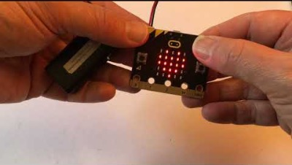
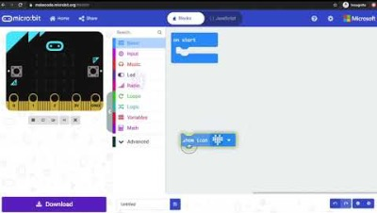
Step1: The Project Show Your Love
What is it?
Light up your micro:bit with love by showing a heart.
What do I need?
micro:bit (or MakeCode simulator) with USB
MakeCode or Python editor
Battery pack (optional)

Slide 11
Step 2: How Does it Work?
The program shows a heart picture on the micro:bit’s LED display output.
The heart stays on the display as long as it has power because you haven’t given it any further instructions to show anything else.
The micro:bit has a set of other built-in images you can use in your projects.
Pictures on computers, phones and tablet screens are made using dots called ‘pixels’. The micro:bit’s display has 25 LED pixels arranged in a 5 x 5 grid.

Slide 12
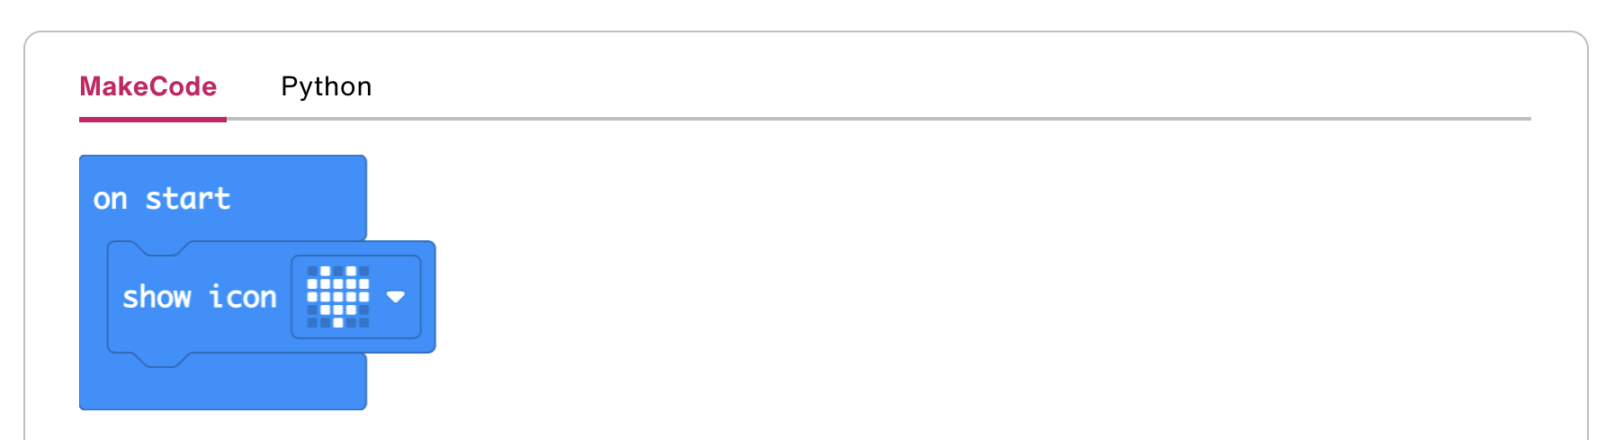
Step 3: Read the Code and Start Making!

Slide 13
Step 4: Share Your Creation!

Slide 14
Step 5: Improve It
Try choosing other built-in pictures like HAPPY, DUCK or GHOST.
Can you show more than one image?

Slide 15
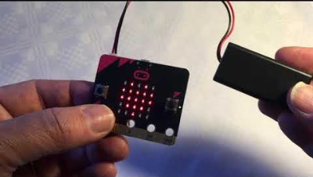
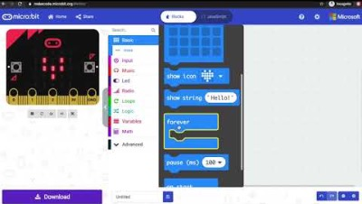
Step1: The Project Beating Heart
What is it?
Make your micro:bit’s heart beat using loops to create an animation.
What do I need?
micro:bit (or MakeCode simulator) with USB
MakeCode or Python editor
Battery pack (optional)

Slide 16
Step 2: How Does it Work?
How does it work?
The program shows a beating heart using two built-in pictures, a large and small heart, on the micro:bit's LED display.
Different images shown in a sequence create the illusion of movement: a heart getting larger and smaller.
After showing each image, the program pauses for half a second (500 milliseconds) before showing the next image.
The animation is kept going forever using an infinite loop: it repeats the sequence of showing these two images and pausing until you unplug the micro:bit.
Using loops to keep things happening is an important idea in computer programming: we have created an animation that will keep running for as long as the micro:bit has power using only a small amount of code. This is also called iteration

Slide 17
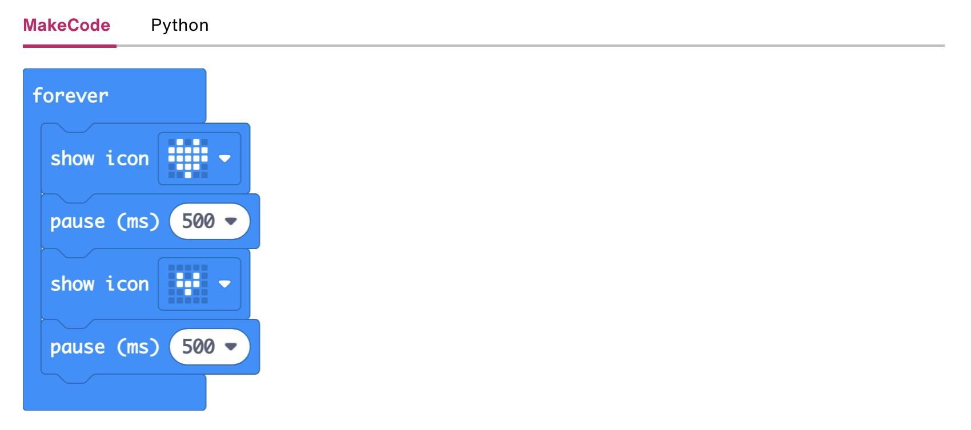
Step 3: Read the Code and Start Making!

Slide 18
Step 4: Share Your Creation!

Slide 19
Step 5: Improve It
Make the heart beat faster or slower by changing the delay time.
Try animating other built-in images like the small and large diamond or square.
Create your own animations using your own designs.

Slide 20
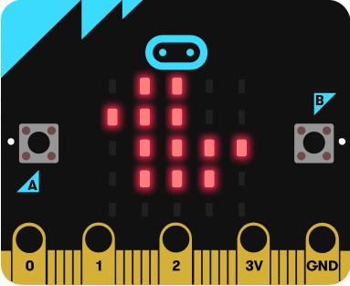
Step 1: The Project Animal-ation!
What is it?
Animate your own pictures on the micro:bit display.
What do I need?
micro:bit (or MakeCode simulator) with USB
MakeCode or Python editor
Battery pack (optional)
Graph paper or LED planning sheet to sketch out your own animal designs (optional)

Slide 21
Step 2: How Does it Work?
This program creates an animation on the micro:bit’s LED display output by using a built-in image and one you create yourself.
First it shows the duck built-in image and then shows a modified version, which is made by moving all the dots (pixels) down one row.
It shows the two different pictures one after the other, with a half second (500 millisecond) delay, to make it look like a duck bobbing up and down on the water.
An infinite loop keeps the micro:bit showing the image sequence until you unplug the micro:bit.
Using loops in computer programmes is also known as iteration. They help you create efficient compact code without needlessly repeating the same instructions.

Slide 22
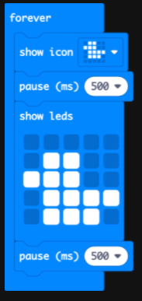
Step 3: Read the Code and Start Making!

Slide 23
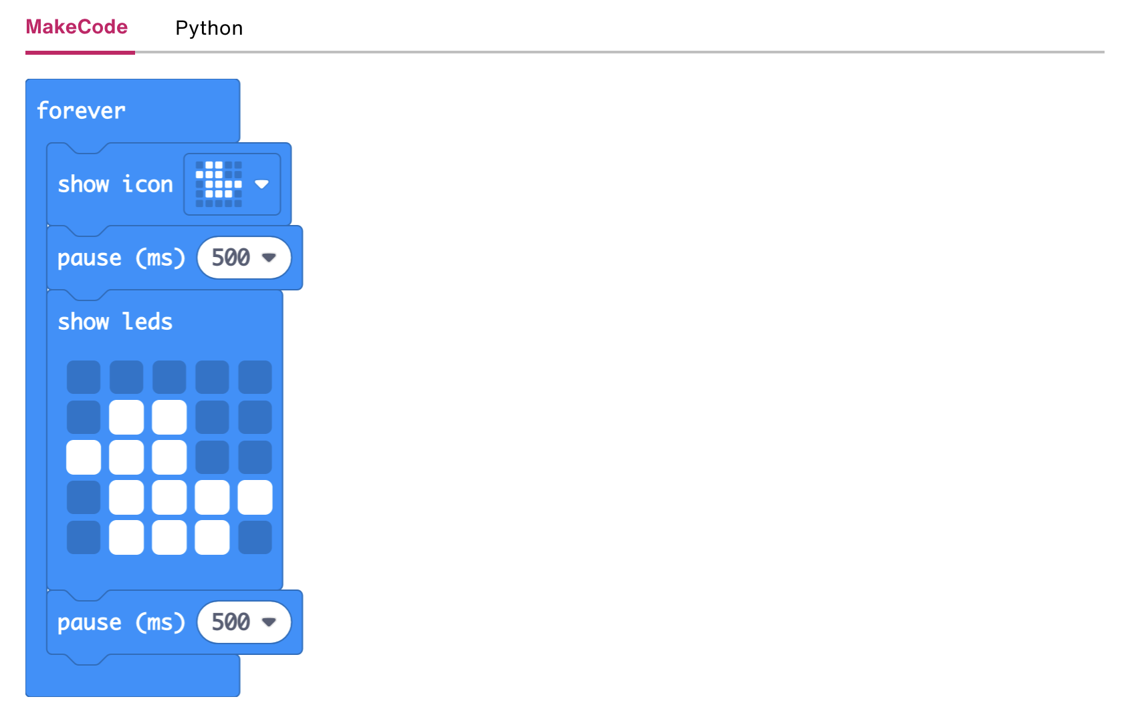
Step 3: Read the Code and Start Making!

Slide 24
Step 5: Improve It
Try modifying and animating different built-in images like GIRAFFE and RABBIT.
Create your own images from scratch using graph paper or our LED planning sheet to sketch out your designs.
Make longer animated sequences to tell a story.
In Python, use different numbers to change the brightness of different pixels. 9 is the brightest, 1 is the dimmest and 0 is off.

Slide 25
BREAK!
10 jumping jacks, please!

Slide 26
PART II: Emotion Badges
Let’s start making!

Slide 27
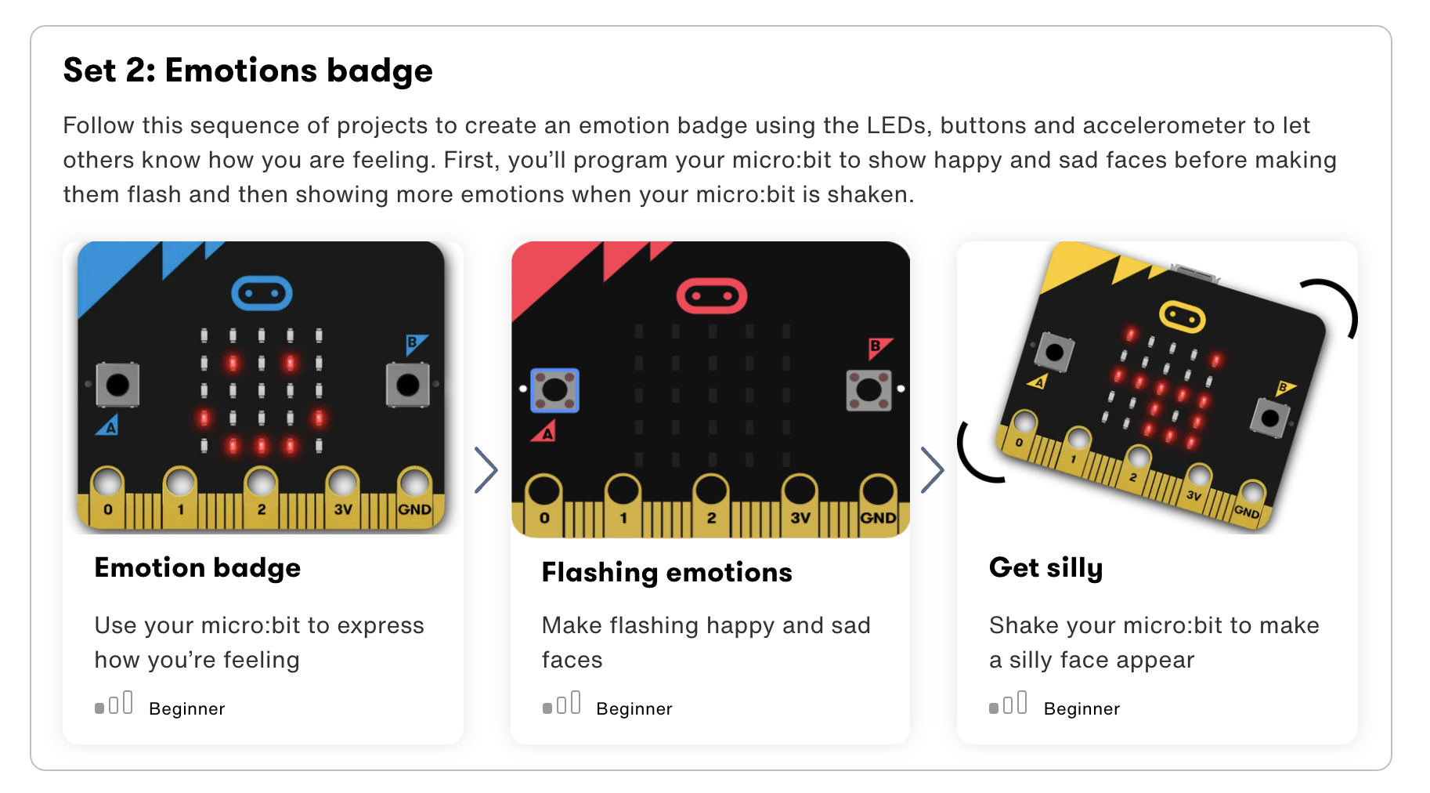

Slide 28
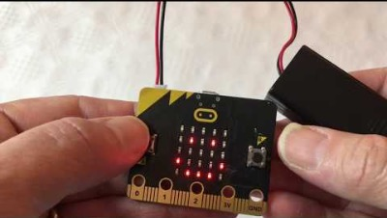
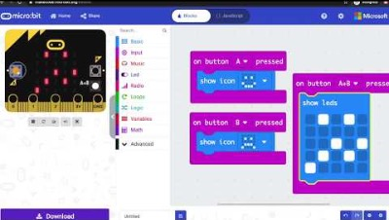
Step 1: The Project Emotion Badge
What is it?
Use your micro:bit to tell the world how you’re feeling.
What do I need?
micro:bit (or MakeCode simulator) with USB
MakeCode or Python editor
Battery pack (optional)

Slide 29
Step 2: How Does it Work?
The micro:bit has two input buttons on the front you can use to make things happen.
When you press input button A the program reacts by showing a happy face image on the LED display output.
Pressing button B makes a sad face appear.

Slide 30
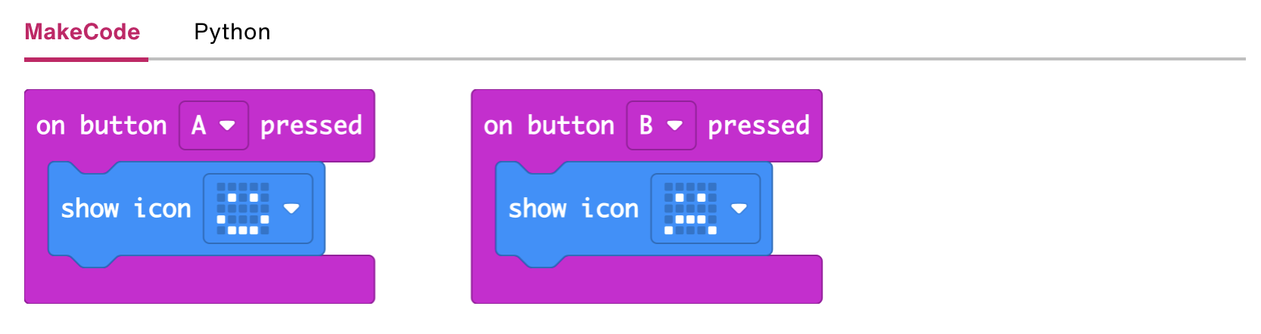
Step 3: Read the Code and Start Making!

Slide 31
Step 3: Read the Code and Start Making!

Slide 32
Step 5: Improve It
Try other emotion images such as ASLEEP, CONFUSED or MEH.
Design your own 'emoticons' using the LED display.
Use the badge to show if you need help or make class voting badges with ticks or crosses.
Design a way of wearing your micro:bit badge using thread, or tape. (Don't use safety pins as the metal could damage your micro:bit.)

Slide 33
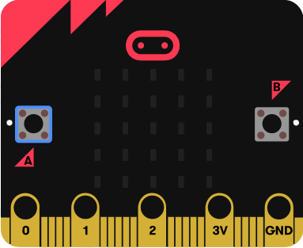
Step 1: The Project Animated Badge
What is it?
Make your feelings really stand out with flashing happy and sad faces.
What do I need?
micro:bit (or MakeCode simulator) with USB
MakeCode or Python editor
Battery pack (optional)

Slide 34
Step 2: How Does it Work?
Like the Emotion badge project, this program shows different emotion images on the LED display output depending on which button input you press.
Loops can make sets of instructions run for ever, but here we use a numbered loop to flash the image 4 times to make it really eye-catching.
Loops are an important idea in computer programming as they save repeating the same code many times, making your program more efficient. This idea is also called iteration.

Slide 35
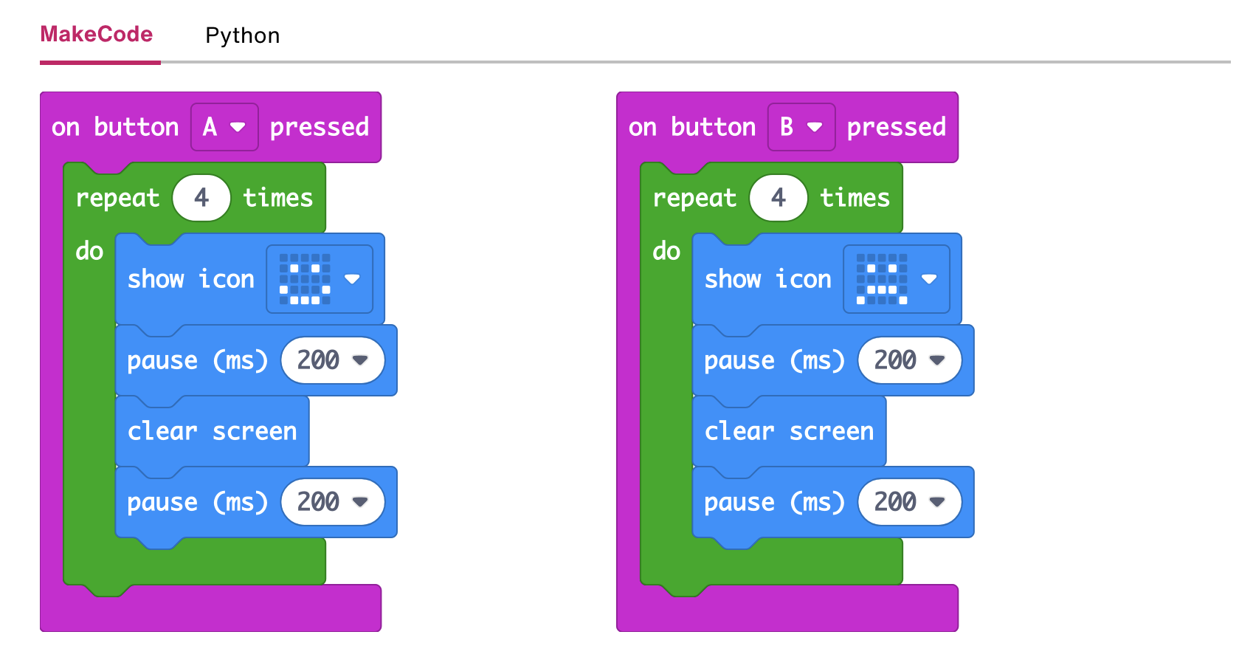
Step 3: Read the Code and Start Making!

Slide 36
Step 3: Read the Code and Start Making!

Slide 37
Step 5: Improve It
Make the badge flash more times by making the number 4 larger.
Make the flashing faster or slower by changing the delay of 200 milliseconds (0.2 seconds).
Make it flash forever.
Use different emotion images, or draw your own

Slide 38
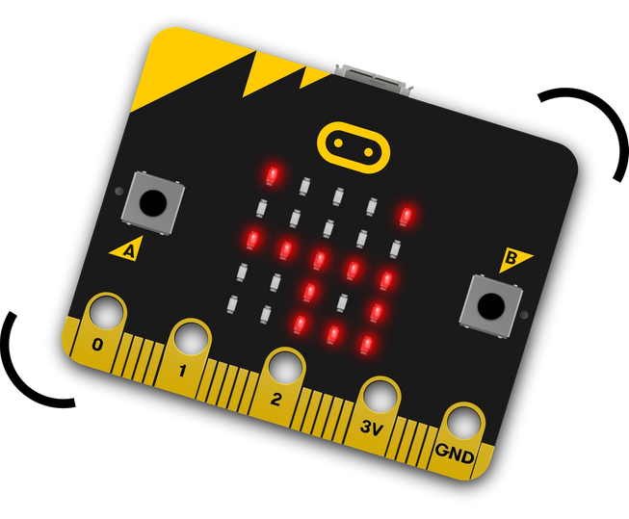
Step 1: The Project Silly Badge!
What is it?
Expand the range of emotions you can show – jump up and down to show that you’re feeling silly!
What do I need?
micro:bit (or MakeCode simulator) with USB
MakeCode or Python editor
Battery pack (optional)
some energy to shake, jump or get silly

Slide 39
Step 2: How Does it Work?
Like the Emotion badge, this program shows a happy or sad face depending on which button input you press, A or B.
The micro:bit has other inputs, such as sensors.
This program uses the micro:bit’s accelerometer input to measure forces and sense when it’s shaken.
When the accelerometer senses sudden movement the program makes the silly face appear on the LED display output.

Slide 40
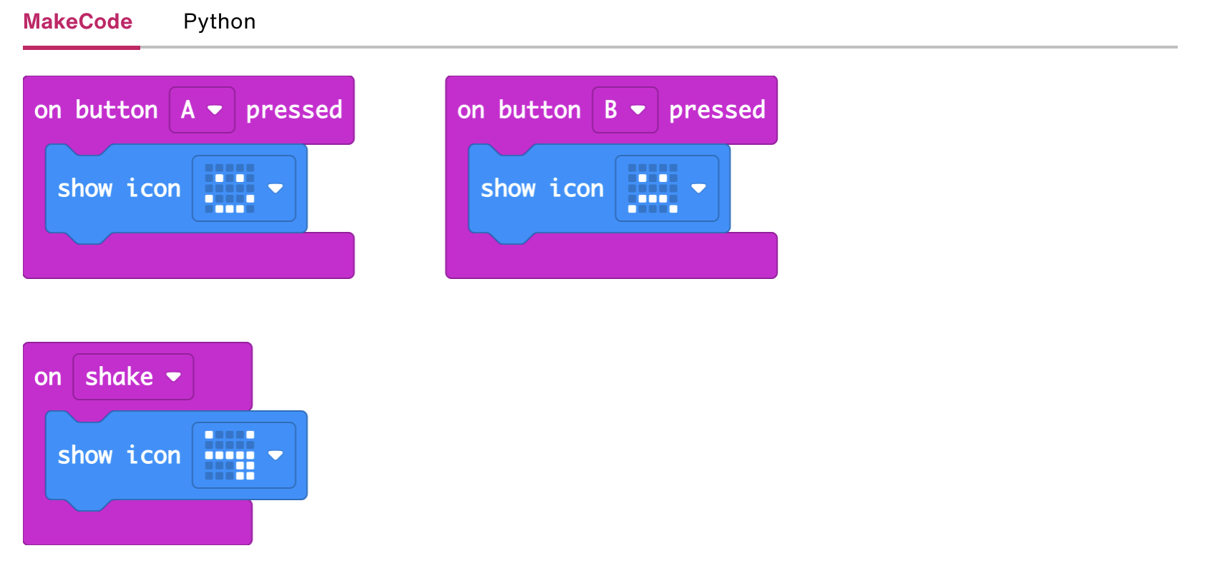
Step 3: Read the Code and Start Making!

Slide 41
Step 3: Read the Code and Start Making!

Slide 42
Step 5: Improve It
Use different built-in emotions images like MEH, CONFUSED or ANGRY.
Show another emotion when you press buttons A and B together.
Add new emotions using the LED display to draw your own pictures like we did in Animated animals.

Slide 43
TIME TO PUT AWAY OUR MICRO:BITS!
Neat and tidy, please!
Let’s leave this beautiful room as lovely as we found it!

Slide 44
NEXT TIME
Playing with Sensors!!

Slide 45
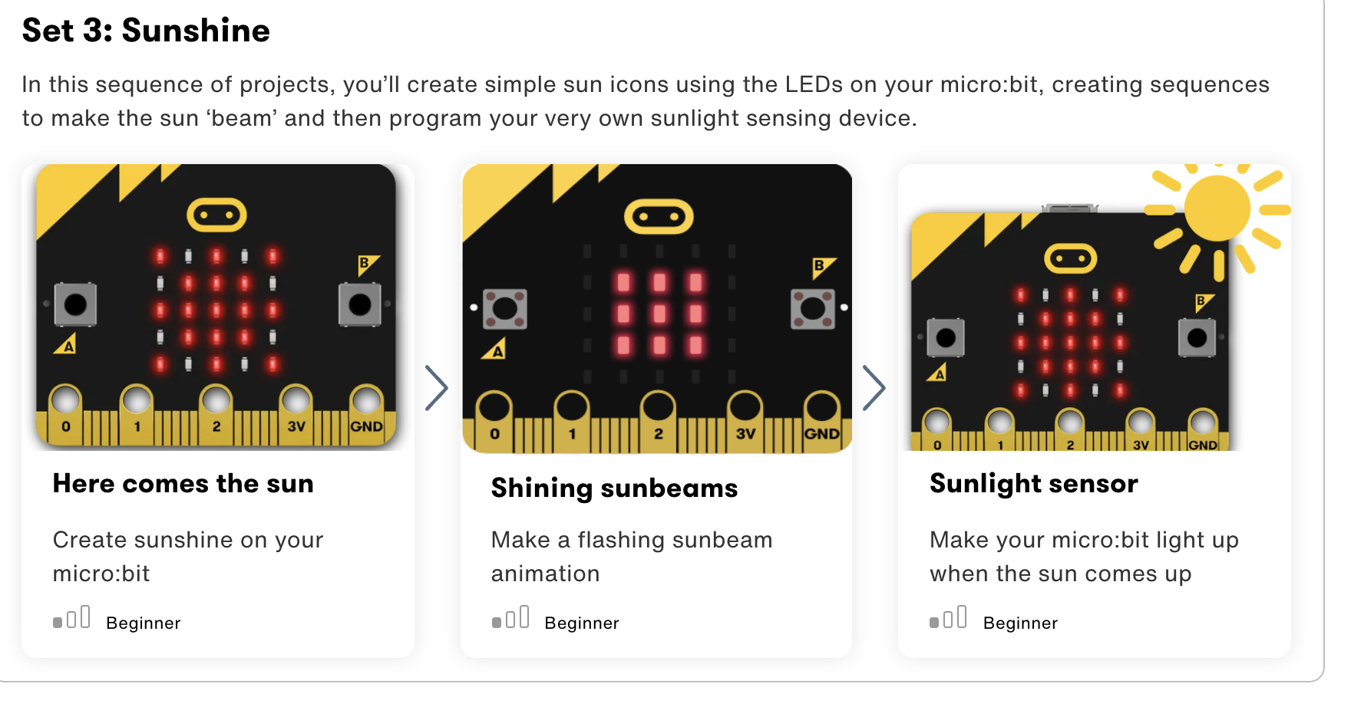

Slide 46
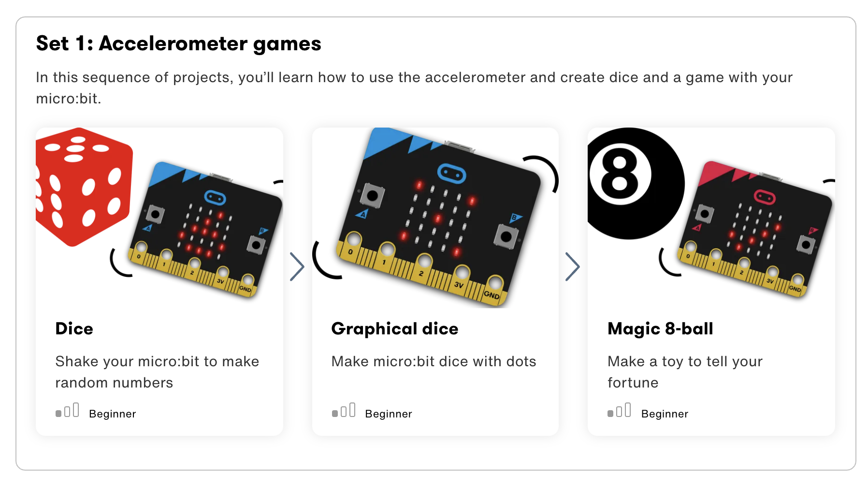

Slide 47

UNTIL NEXT TIME….
MicroMakers!
Slides and Script: Holly Krambeck (learningpython64@gmail.com)
Project Videos, Images, and Text: https://microbit.org/get-started

